Slide 1


DESIGN THINKING AND INNOVATION
AIML
MY TEAM MEMBERS
MOHAMED ARIFF
MOHAMED KYUF
MOHAMED RAFI
MOHEMMED SAJID

Slide 2

RECYCLING USED OLD THINGS

Slide 3

BRAIN STROMING

Slide 4
KEYWORDS
WASTE SORTING
RECYCLING INCENTIVES
END OF LIFE PRODUCTS
RECYCLING EDUCATION
ENVIRONMENTAL RESPONSIBLE
RESOURCE EFFICIENCY
RECYCLING RATES
INDUSTRIAL RECYCLING
MUNICIPAL RECYCLING
RECYCLING INDUSTRY

Slide 5
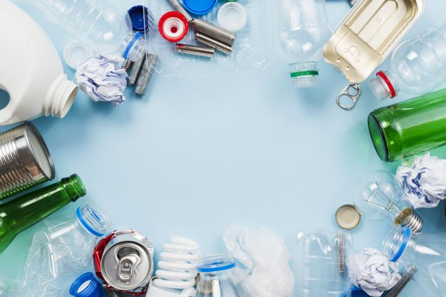
Plastic
Recycling
Battery Recycling
Organic Waste
Waste Sorting
Glass Recycling
Recycling Policies
Resource recover
Collection Program
Paper Recycling
Landfill diversion
Recycling Bin
E-Waste
Textile Recycling
Waste Reduction
Screen Material
Recycling Rates
Metal Recycling
Recycling Awarness
Green initiation
Bio- degradable

Slide 6

Repurposed Art
Post Consumer Waste
Circular
Economy
Antique
Zero Waste
Environmental impact
Second hand
Vintage
Eco-Design
Reuse
Salvaging
Resale
Upcycled
End of life
Reclamation
Clutter-free
DIY upcycling
Collection program
Thrift stores
Repair

Slide 7
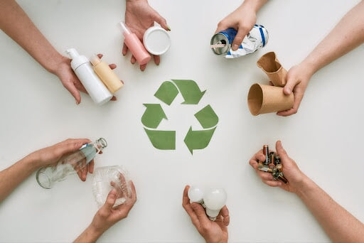
Sorting and Affinity Link
Recycling and Waste Management
Upcycling and Repurposing
Sustainable and Environmental impact
Materials and Products
Plastic Recycling
Repurposed Art
Renewable Resources
Energy Efficiency
Recycling
Bio-degradable
Plastic Bags
Vintage
Paper Recycling
Green Products
Eco-friendly Practices
Upcycled
Glass Recycling
DIY Upcycling
Eco-Projects
Eco design
Food Scraps
E-Waste
Green Living
Sustainable
Materials
Landfill Diversion
Cans
Zero Waste

Slide 8

MIND MAPPING

Slide 9








Zero Waste
Green Living
Eco-design
Green Products
Biodegradable
Upcycled
Cans
Food Scarps
Energy efficiency
Recycling and Waste Management
Materials and Products
Recycling used Old Things
Sustainability and Environmental impact
Upcycling and Repurposing
Sustainable material
Repurposed Art
Vintage
Eco-projects
Eco-friendly
Recycling
Class Recycling
Landfill diversion
E-Waste
Plastic Recycling

Slide 10
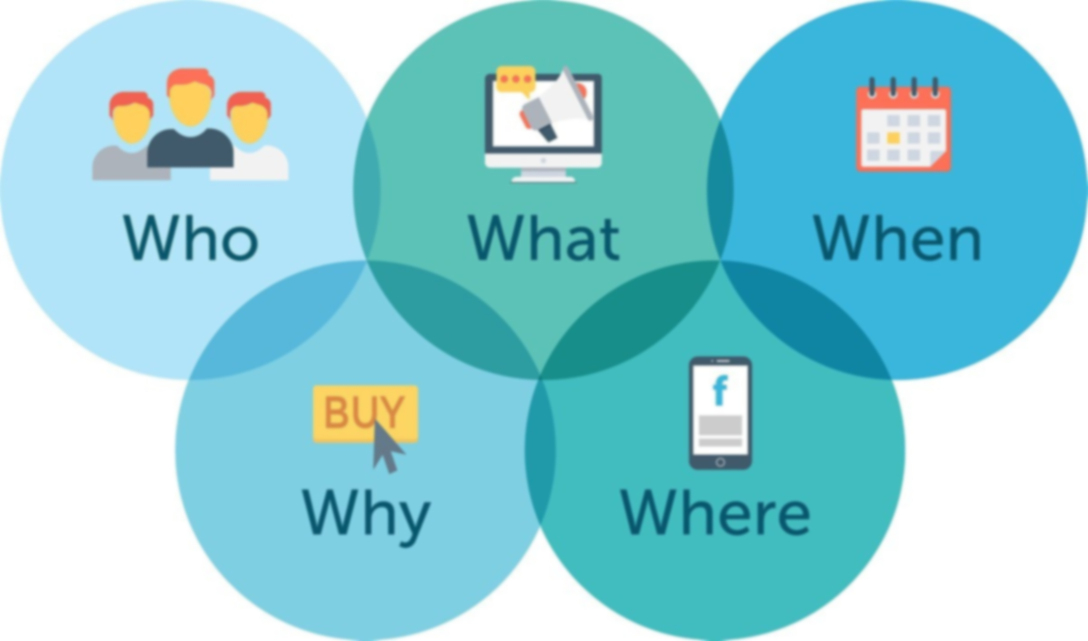
5W+1H + MATRIX
TABLE

Slide 11




 | Municipal governments, private waste management companies, businesses. | Individuals, artists, designers, businesses, and organizations interested in sustainability. | Governments, businesses, non-profit organizations, and individuals all play critical roles. | Manufacturers, designers, and companies are responsible for producing materials and products.
 | Recyclable materials go to recycling facilities where they are sorted, cleaned, and processed. | At home, in workshops, at community centers, or by specialized businesses and artisans. | Globally, across all sectors—energy, agriculture, manufacturing, transportation, and beyond. | Products are used globally and can end up in landfills, recycling centers, or second-hand markets after use.
 | Collection schedules vary by location; usually, recycling and waste are collected weekly or biweekly. | When an item is no longer needed for its original purpose. When seeking creative and sustainable solutions for reducing waste | When should actions be taken to mitigate environmental impacts? Continuously, with both immediate and long-term strategies. | This can vary widely, from single-use items disposed of immediately, to durable goods that last years or decades.

Slide 12


 | Reduces pollution, conserves resources, and minimizes the amount of waste sent to landfills. | They help reduce waste, conserve resources, and minimize the environmental impact of production and consumption. | To protect the health of the environment, which is crucial for human survival, economic stability. | To reduce environmental impact, ensure ethical production, and promote long-term resource conservation.
 | Through education, accessible recycling programs, proper sorting, and government policies that encourage or mandate recycling. | Promote these practices through workshops, social media, or community events to inspire others to participate. | By reducing emissions, protecting natural habitats, reducing consumption | By considering the product's lifecycle, checking for certifications, and opting for eco-friendly, ethical, or locally-made options.

Slide 13
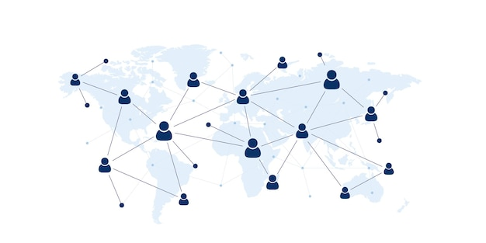
User-Participant Mapping

Slide 14









Focus on Policy change
Electronic recycling
Conduct Studies
Enhance Recycling
Construction Project
Reduce raw Material
Instrument
Public Education
Reduce Waste
Co-operate reputation
Furniture
Recycling used Old Things
Harzardous waste
Producting Level
Eco friendly act
Support Bussiness
Home Decor
Technology Product
New technology
Recycling Metal
Primary Level
Global Co-Operation
Secondary Level
Tertiary Level
Quaternary Level

Slide 15

CONTEXTUAL INQUIRY

Slide 16
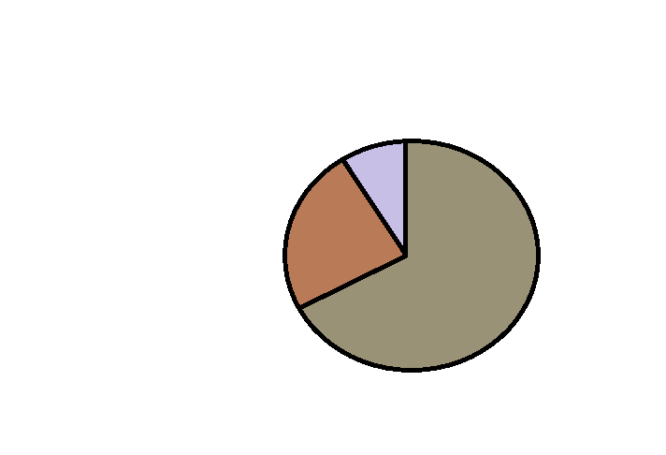

DEMOGRAPHICS
5%
25%
70%
Male
Female
Children

Slide 17

AGE RANGE OF USERS
120
100
80
60
40
20
0
1 2 3 4 5

Slide 18

CONCEPTUAL MODEL
Collection
Transportation
Sorting
V
Processing
Manufacturing

Slide 19
Distribution
C
Consumption
Education and advocacy
Monitoring and Improvement
Final output

Slide 20
QUESTIONNAIRES AND CUE CARDS

Slide 21
QUESTIONNAIRES AND CUE CARDS
USER FEEDBACK QUESTIONNAIRE FOR RECYCLING USED OLD THINGS
 | 1.INADEQUATE | 2.FAIR | 3.GOOD | 4.VERY GOOD | 5.EXCEPTIONAL
1.How easy to recycle |  |  |  | ✓
2.How helpful resources are provides |  |  | ✓
3.How you are motivated to recycle the old items. |  |  |  | ✓
5%
25%
70%
CUE-CARDS General Information – Identify what items were recycled and user frequency. Service Experience – Rate ease, convenience, and communication. Motivations & Suggestions – Find out why users participate and gather feedback. Optional Demographics – Collect age data for better program targeting.

Slide 22
ACTIVITY MAPPING

Slide 23



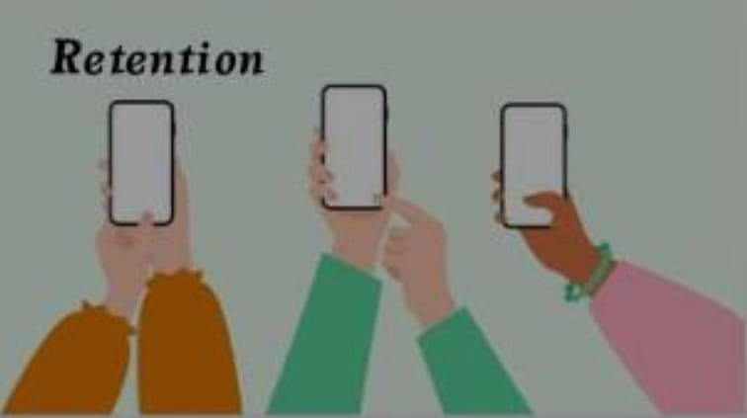



ACTIVITY MAPPING
USER JOURNEY MAPPING
5%
25%
70%

Slide 24
PORSONAS AND OIOR TABLE

Slide 25
PORSONAS AND OIOR TABLE
USED FOR MANUFACTURERS
1.Access recycled materials for unique, eco-friendly artworks and designs.
2.Reduce waste by reusing discarded items creatively.
OBSERVATION | INFERENCE | OPPURTUNITY | RECOMENDATION
Reduces Waste: Recycling minimizes landfill use and pollution. | Extends Product Life: Recycling gives new purpose to old items. | New Products Creation: Old items can be transformed into valuable goods. | Sort Waste Properly: Separate recyclables from regular trash.
Saves Resources: It conserves raw materials like metals and wood. | Reduces Environmental Harm: It limits waste and pollution. | Business Opportunities: Encourages startups in recycling and resale markets. | Promote Upcycling: Encourage creative reuse of old items.
Creates Jobs: Recycling industries generate employment opportunities | Promotes Sustainability: Conserves resources for future use. | Community Engagement: Promotes eco-friendly practices and awareness | Support Recycling Programs: Participate in local recycling initiatives.
5%
25%
70%

Slide 26
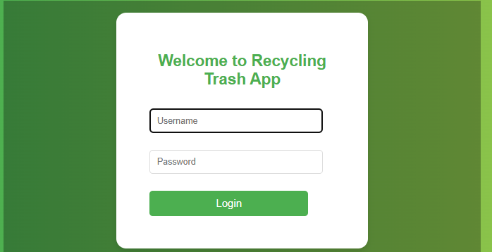
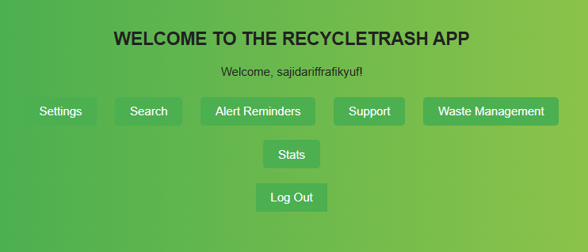
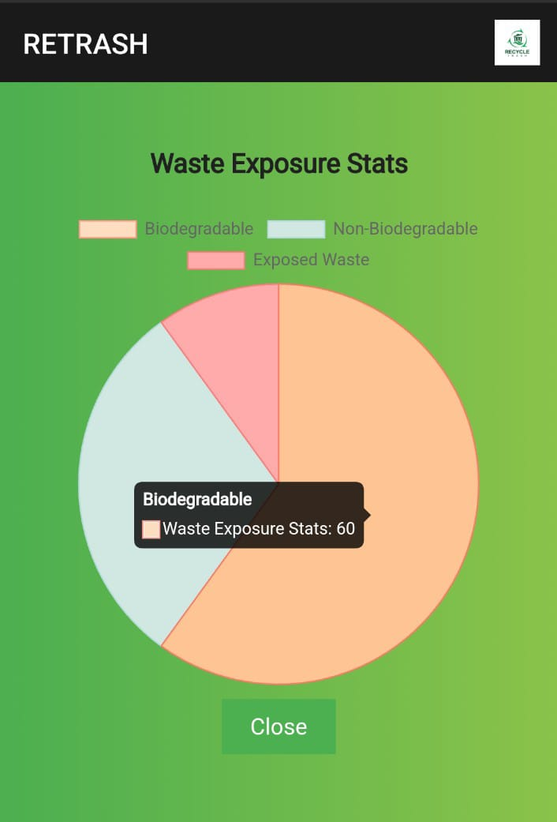
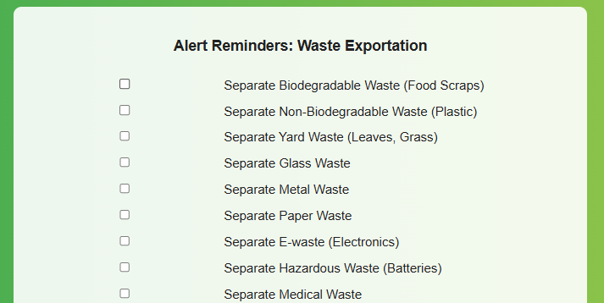
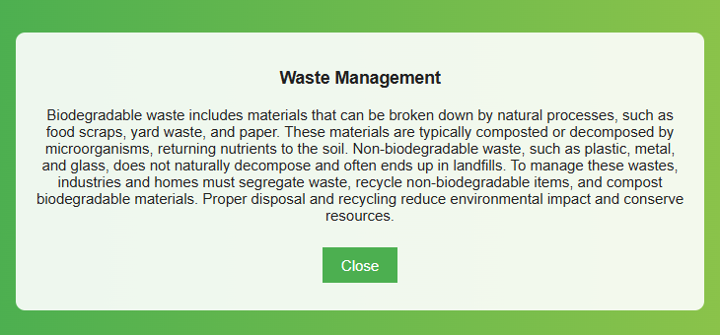
Prototype screenshots
USER NAME
OPTIONS AVAILABLE IN OUR APP
STATS ACCORDING TO WASTE EXPOSURE
5%
25%
ALERT REMAINDERS AND CHECKBOX
SMALL AWARNESS AMONG WASTE MANAGEMENT
70%

Slide 27
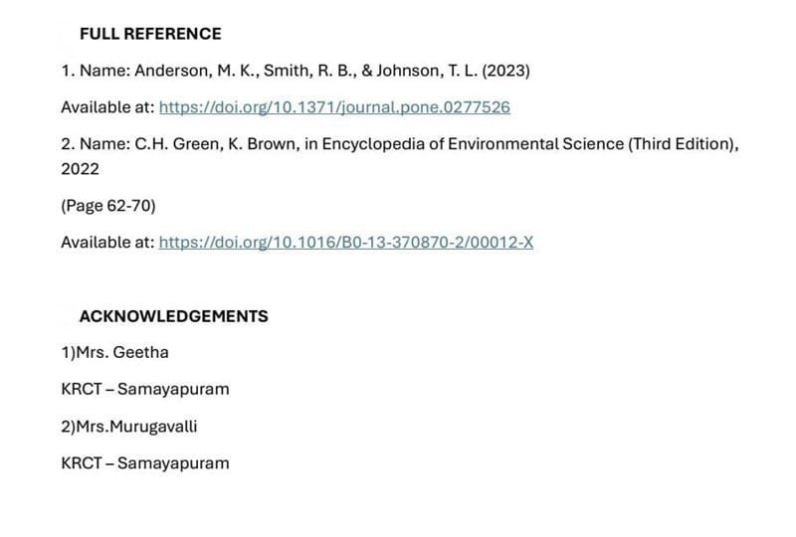
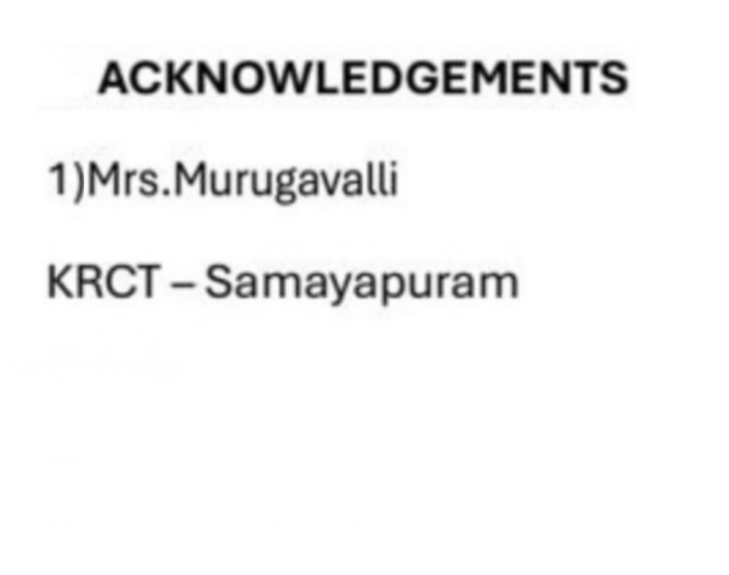
FULL REFERNCE AND ACKNOWLWDGEMENT
5%
25%
70%

